Slide 1



Cyberbullying Detection in Gaming Platforms Using NLP
PROJECT GUIDE
Dr.M.Abirami

Slide 2
Introduction
1
The Rise of Gaming
2
The Dark Side of Online Interactions
3
The Need for Intervention
Gaming has experienced a remarkable growth in popularity, with millions of players worldwide engaging in a wide variety of games across various platforms. This growth has led to the formation of variety of online communities, where players can connect, compete, and share their passion for gaming.
Addressing cyberbullying in gaming platforms is crucial, as it can have direct effects on player's mental health , inner peace , and overall gaming experience. Developing effective solutions to detect and reduce such behavior is essential for building a safe gaming community.
However, the lack of face to face interaction in online gaming environments have also enabled the act of cyberbullying, a concerning problem where individuals engage in abusive, harassing, or threatening behavior towards others.

Slide 3
Problem Definition
Growth of Cyberbullying
Limitations of Current Approaches
Importance of Player Experience
Cyberbullying has become an important issue within gaming platforms, with many reports of players experiencing abusive, harassing, or threatening behavior from other players . This problem not only affects individual players but also affects the overall gaming community.
Existing methods for addressing cyberbullying, such as manual moderation or keyword-based filtering, have proven to be insufficient in keeping up with the scale and complexity of the problem. There is a need for more advanced, automated solutions that can effectively detect and respond to cyberbullying incidents in real-time.
The gaming experience is to reduce the stress but the presence of cyberbullying can make the players more stressful and it also ruins their enjoyment . Effective solutions are needed to ensure a safe and inclusive environment for all players, regardless of their skill level or background.

Slide 4
Objective
Automated Cyberbullying Detection
Real-time warning and banning
Building a Safer Gaming Environment
This project aims to build a system that automatically detects cyberbullying in gaming platforms. The system will analyze player communications to identify abusive or harassing behavior using NLP techniques.
The system will not only detect cyberbullying but also respond with appropriate warnings, and also banning the user from the game.
The goal is to create a safer gaming experience for all players. By detecting and reducing cyberbullying, the system will promote safety and respect within the gaming community.

Slide 5
Approach and Ideas
1
Cyberbullying in Among Us
We observed a significant amount of cyberbullying in the popular game called "Among Us", especially during the COVID-19 pandemic. This behavior included players using profanity, abusive language, and personal attacks.
2
Developing a Cyberbullying Detection Model
Motivated by this issue, we decided to create an NLP-based cyberbullying detection model that could identify and flag offensive messages in real-time.
3
Integration with a Temporary Chat App
We then integrated our model into a temporary chat app specifically designed for Among Us, allowing us to automatically detect and reduce cyberbullying within the gaming environment.

Slide 6
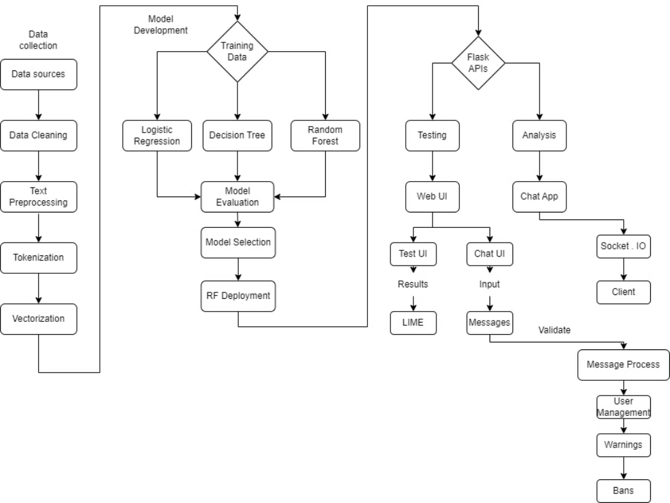
System Architecture

Slide 7
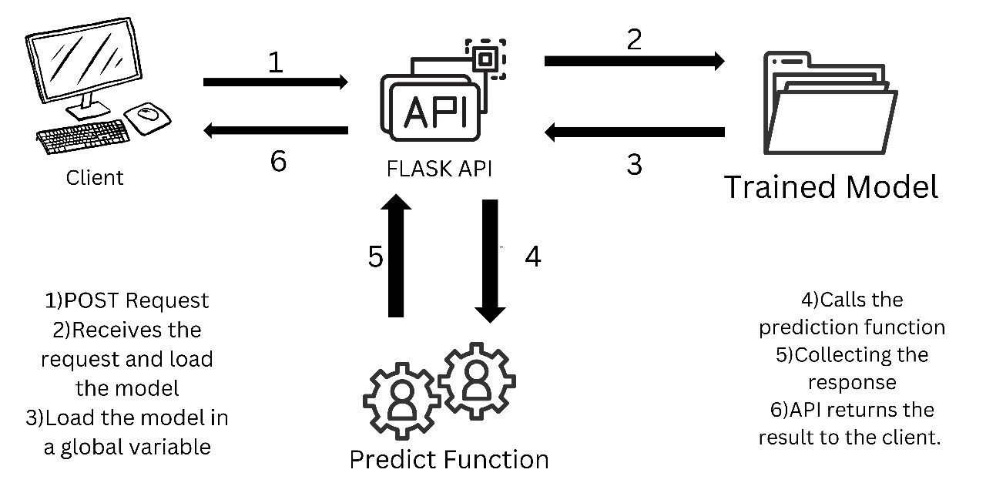
Detailed Design

Slide 8






Technologies Used
Python
React.js
HTML
CSS
Node.js
Tailwind CSS

Slide 9





Tools Used for the Project
Data Preprocessing
1
pandas, numpy
2
Machine Learning
scikit-learn, TF-IDF, Random Forest, Decision Tree, Logistic Regression
3
Text Preprocessing
NLTK, spaCy
4
Evaluation
sklearn.metrics, matplotlib, seaborn
5
Storage
pickle, joblib

Slide 10

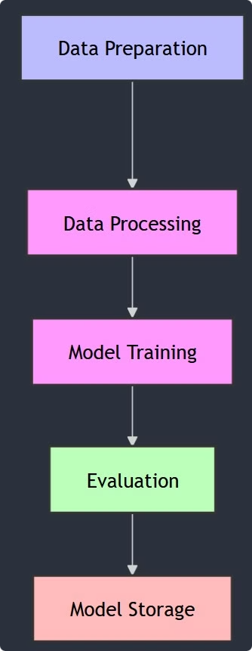





Model Training
Data Preparation
Cleaning, organizing, and transforming raw data into a format suitable for analysis and modeling.
Data Processing
Applying transformations and feature extraction techniques to the data to make it ready for model input.
Model Training
The phase where the machine learning model learns patterns from the prepared data by adjusting its parameters based on input-output relationships.
Evaluation
The process of evaluating the model's performance using specific metrics on test data to measure its accuracy and generalization.
Model Storage
Saving the trained model to a file or database for future use, deployment, or further evaluation.

Slide 11
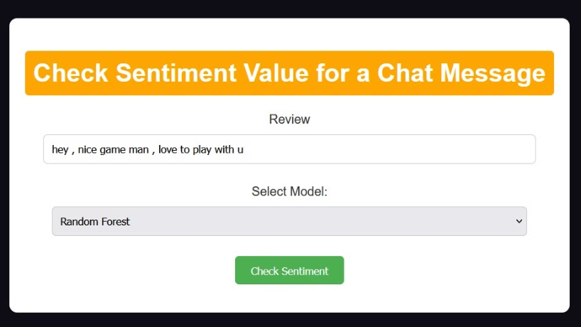
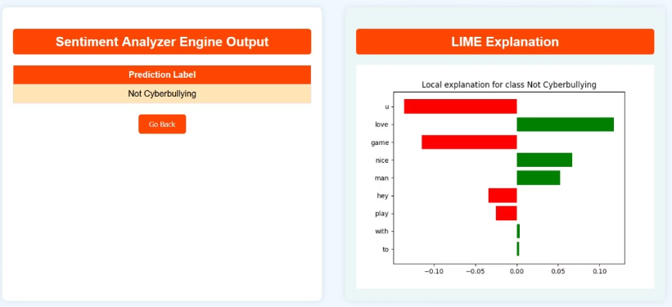
Screenshots

Slide 12
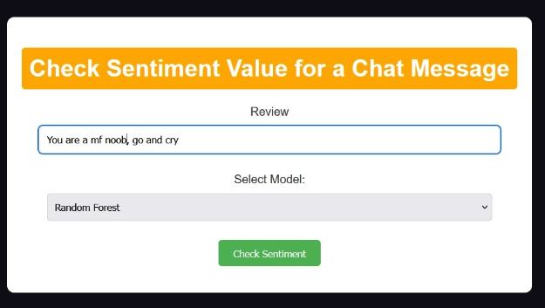
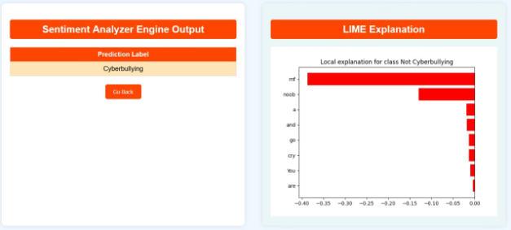
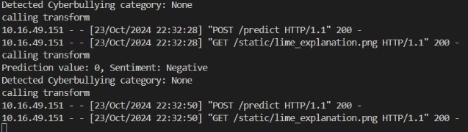
Screenshots

Slide 13
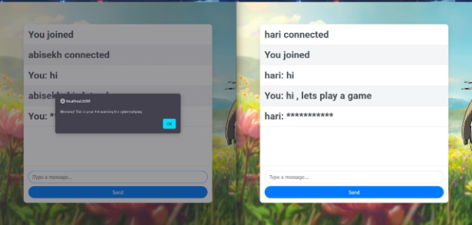
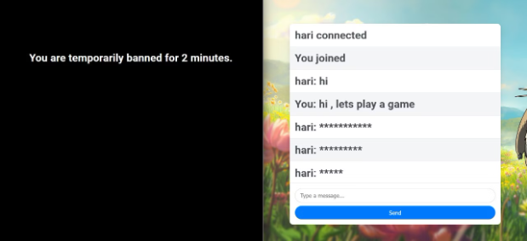
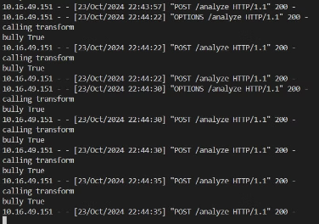
Screenshots

Slide 14
Results and Discussions
Reduction in Reported Cyberbullying Incidents
Precision Score
AUC Score
F1 Score
Random Forest
0.959905
0.975699
0.959439
Decision Tree Classifier
0.953869
0.943126
0.9546197
Logistic Regression
0.926923
0.948744
0.922598

Slide 15

References
CYBERBULLYING DETECTION USING SENTIMENT ANALYSIS IN SOCIAL MEDIA Research Paper
Machine Learning and Semantic Analysis of In- game Chat for Cyber Bullying by Dr Shane Murnion, Prof William J Buchanan, Adrian Smales, and Dr Gordon Russell
IBM Technology Youtube Channel
Devvrat Rana Youtube Channel

